Slide 1
Machine learning project: Stroke prediction
Professor: Ivan Serina
Student: Okba Kharef
1

Slide 2
Introduction.
Methodology.
Results and applications.
Index
Conclusions.
2

Slide 3
The problem & Project Goal
High Impact: Stroke is the 2nd leading cause of death globally (WHO). Early risk identification is critical.
Objective: The primary objective of this project is to build and evaluate various machine learning models to accurately predict a patient's likelihood of having a stroke, with a focus on overcoming the challenge of class imbalance.
4

Slide 4
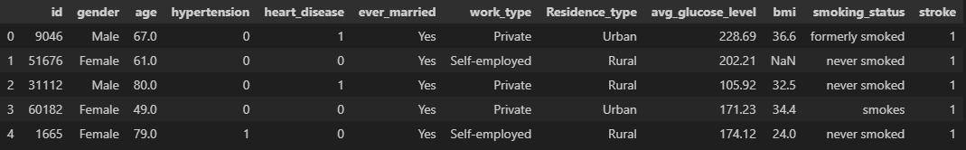
The Dataset
Dataset Overview: A Snapshot of Patient Attributes:
Source: Kaggle's Stroke Prediction Dataset
Size: 5,110 patient records
Features: A mix of numerical (age, bmi, avg_glucose_level) and categorical (work_type, smoking_status) attributes.
Target: A binary variable indicating if a patient had a stroke (1) or not (0).
5

Slide 5
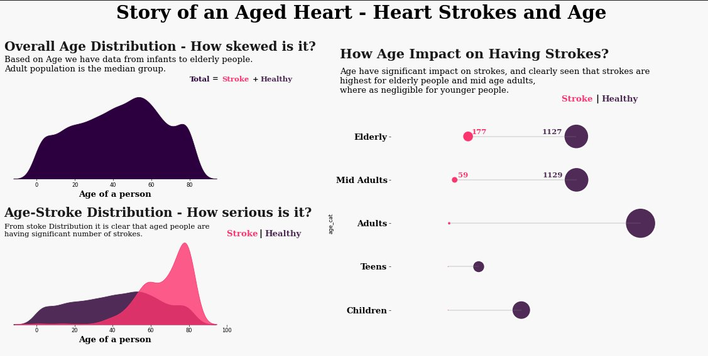
Story of an aged heart

Slide 6
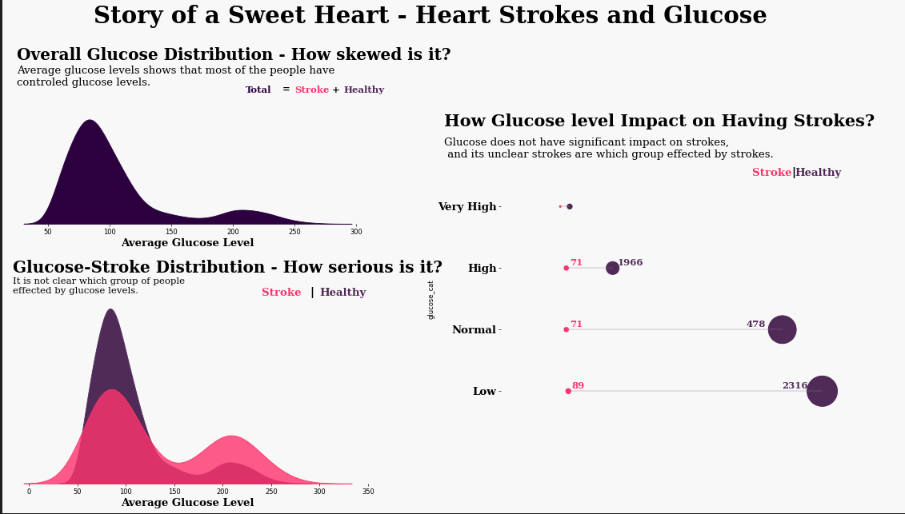
Story of a sweet heart

Slide 7
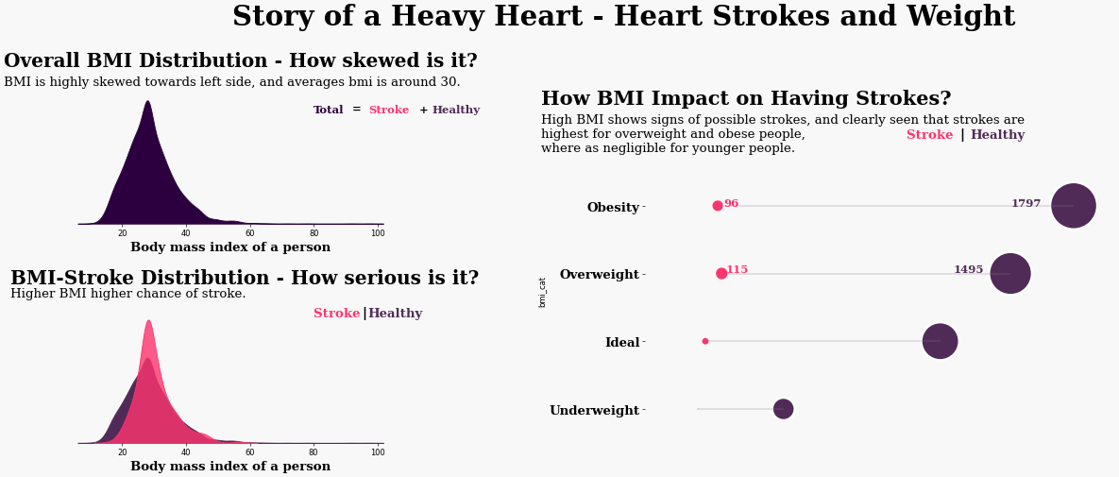
Story of a heavy heart

Slide 8
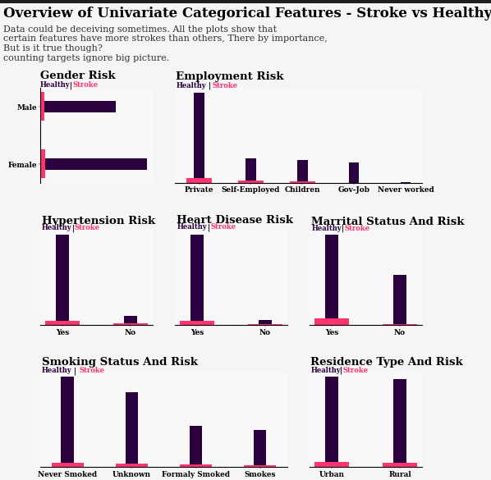
Overview of categorical features

Slide 9
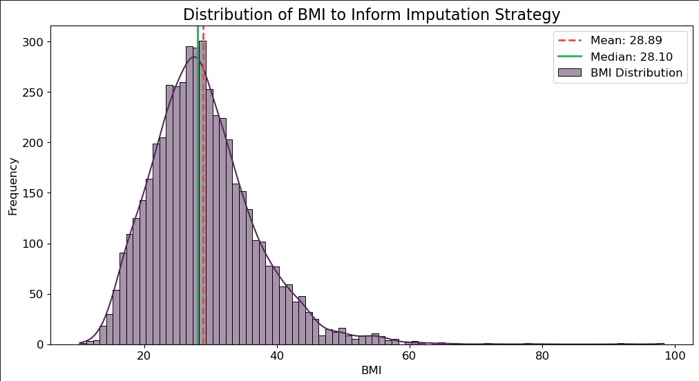
Data Preprocessing: Preparing for Modeling
Handling Missing Values: Filled the 4% of missing BMI values using the Median, as the data distribution was skewed by outliers.
Encoding: Converted all categorical features (like 'work_type') into a machine-readable format using One-Hot Encoding.
Splitting: The dataset was partitioned into an 80% training set and a 20% test set for unbiased evaluation.
We chose the median because, in our right‑skewed BMI distribution with high‑value outliers pulling the mean upward , the median remains unaffected by extreme values and thus more accurately represents a “typical” patient.
8

Slide 10
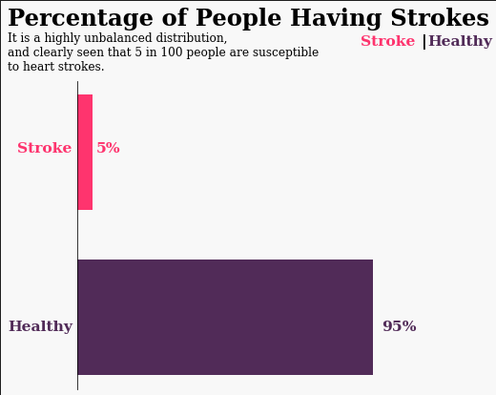
The Core Challenge: Severe Class Imbalance
Imbalance: Stroke cases (positive class) make up only ~5% of the entire dataset.
The Risk: A standard model could achieve 95% accuracy by simply always predicting "no stroke," making it clinically useless.
The Metric Problem: This makes standard accuracy a misleading metric for success.

Slide 11
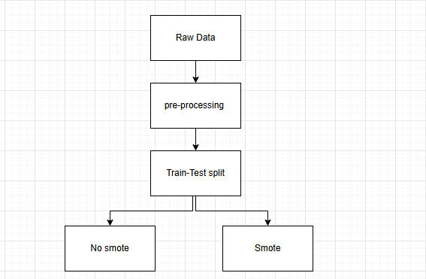
The solution
Solution: Employed SMOTE (Synthetic Minority Over-sampling Technique) to create a balanced training set.
Experiment 1 (Baseline): Trained models on the original, imbalanced data.
Experiment 2 (Proposed): Trained models on the correctly balanced training data.
Experiment 3 (Demonstration): Intentionally "leaked" data by applying SMOTE before splitting to show the effect of incorrect methodology.
7

Slide 12
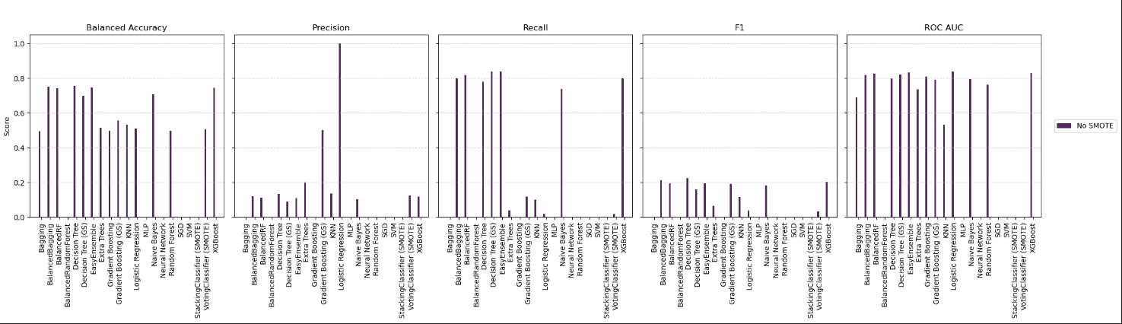
Experiment 1 Results - The Baseline (No SMOTE)
Primary Finding: Very low Recall across all models.
Interpretation: The models are skilled at identifying non-stroke patients but fail to detect the actual stroke cases.
Conclusion: This approach is not clinically useful as it misses the patients we most need to find.
8

Slide 13
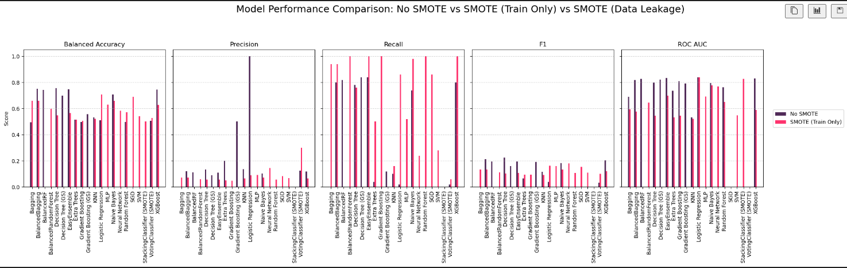
Experiment 2 Results - The Solution (SMOTE)
Primary Finding: A massive increase in Recall for all models.
Trade-off: Precision scores decreased slightly, which is an expected trade-off.
Conclusion: The F1-Score (balancing Precision and Recall) shows a clear net improvement for top models, making this a successful strategy.
9

Slide 14
Spotlight: The Neural Network's Performance
Objective: To design a Deep Neural Network (DNN) capable of learning complex, non-linear patterns from the SMOTE-balanced dataset.
Structure:
Input Layer: Accepted 17 features from our processed data.
Hidden Layers: A deep stack of Dense (fully-connected) layers using ReLU activation to model intricate relationships.
Output Layer: A single Sigmoid neuron to produce a stroke probability score (from 0 to 1).
Key Technique - Regularization:
Strategically placed Dropout layers (with a 50% rate) were crucial to prevent the model from "memorizing" the synthetic data and to improve its ability to generalize to unseen test data.
High Discriminative Power (ROC AUC: 0.77): This is a very positive result. It shows the model is significantly better than chance at distinguishing between a "stroke" and "no-stroke" patient profile.
Success in Finding Stroke Cases (Recall: 0.24): The primary goal of using SMOTE was to find more true positives. The model successfully identified 24% of all actual strokes in the unseen test data.
9

Slide 15
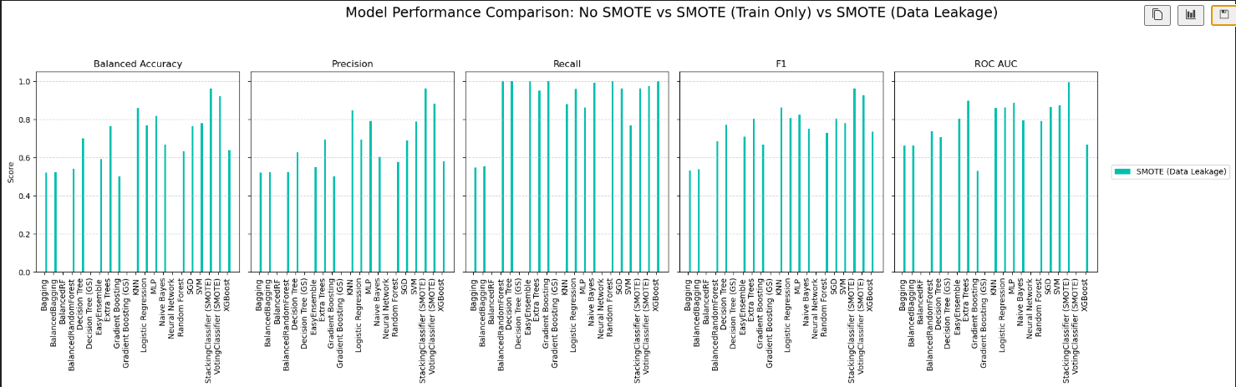
Experiment 3 - The Cautionary Tale (Data Leakage)
Finding: Near-perfect, unrealistic scores across all models.
The Cause: Applying SMOTE before the train-test split. This leaks synthetic data into the test set.
The Lesson: These results are invalid. It's a powerful demonstration of why proper validation protocol is non-negotiable in machine learning.
10

Slide 16
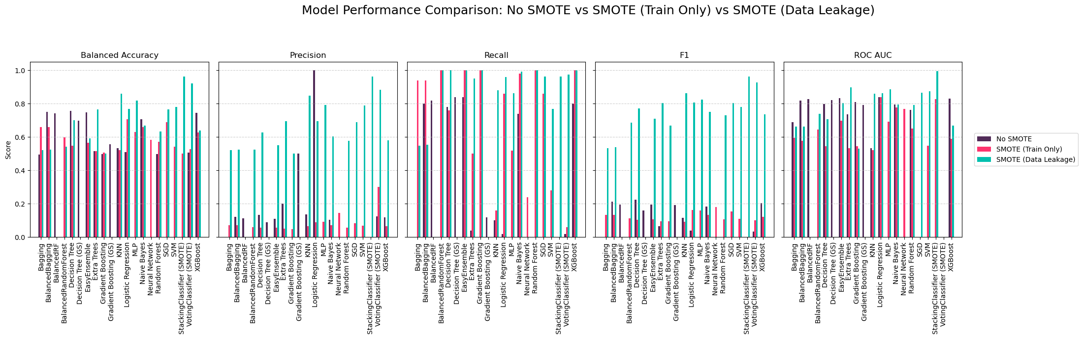
Bringing It All Together: A Comparative View
Blue bars (Data Leakage) show flawed, perfect results.
Purple bars (No SMOTE) show an ineffective, low-recall baseline.
Pink bars (SMOTE) show a successful, balanced approach where top models stand out.
11

Slide 17
Conclusion
Best Models: The Neural Network and XGBoost, when trained on correctly balanced data, provide the most effective and reliable performance.
Methodology is Key: Correctly handling class imbalance with techniques like SMOTE is essential for creating a clinically useful model.
Limitations: The model is constrained by the scope and quality of the single-source dataset.
12

Slide 18
Future Work
Advanced Hyperparameter Tuning: Further optimize the top models to maximize performance.
Model Explainability (XAI): Use tools like SHAP or LIME to understand why the model makes a prediction—critical for clinical trust.
Deployment: Create an API to simulate integrating the model into a real-world clinical support system.
13

Slide 19
Thank you for
The attention
14

